Slide 1
CAPSTONE PROJECT
“ENHANCING COMPILER DESIGN THROUGH EFFICIENT MEMORY MANAGEMENT”
L.Pradeepthi 192211438
Y.Ankitha 192210012
A.Deekshitha 192211838
D.Mega vardhini 192211276

Slide 2
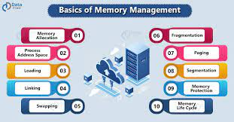
Aim:
Improving the efficiency and performance of compiler software through optimized memory management techniques is the main objective of 'Enhancing Compiler Design Through Efficient Memory Management'.
By implementing more effective memory management strategies within the compiler, the goal is to reduce memory overhead, minimize the occurrence of memory leaks, and optimize overall memory usage.
This results in a more efficient and robust compiler system capable of handling larger codebases more effectively and completing compilation tasks more quickly and reliably.
Ultimately, the aim is to develop compilers that are more efficient, scalable, and capable of meeting the demands of modern software development

Slide 3
Abstract:
This paper explores how efficient memory management in compiler design impacts software performance and resource utilization.
It discusses various techniques, including memory allocation and reuse, and addresses challenges across different programming paradigms and compilation targets.
Advanced features like garbage collection and stack allocation optimizations are also examined.
Real-world case studies highlight the effectiveness of these strategies in reducing runtime overhead and optimizing memory usage.
Overall, the paper emphasizes the importance of efficient memory management in improving program efficiency.

Slide 4
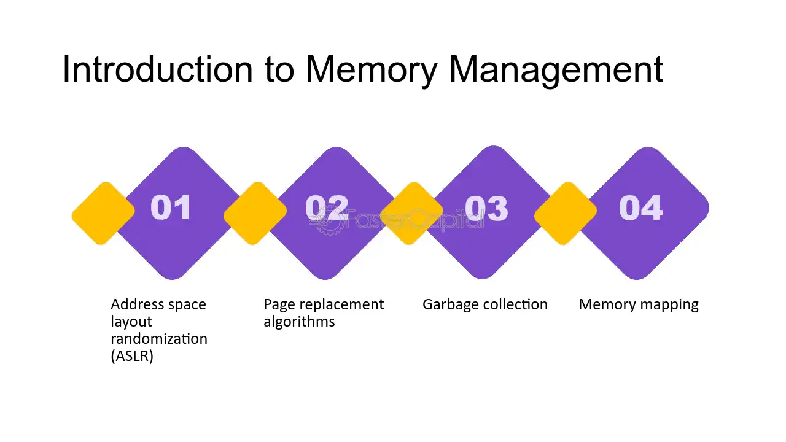
Introduction:
Efficient memory management is vital for optimizing software performance, especially in compiler design.
This introduction highlights the importance of memory management in compiler design and outlines the paper's objectives.
It discusses the challenges posed by dynamic memory allocation and fragmentation and introduces the exploration of various techniques across different programming paradigms and compilation targets.
The paper also addresses advanced features like garbage collection and memory layout optimizations, aiming to provide practical insights for improving memory performance in software systems.

Slide 5
Literature Survey:
The literature on efficient memory management in compiler design encompasses a wide range of techniques and methodologies aimed at optimizing memory usage. Several key areas have been extensively researched and documented:
Static Single Assignment (SSA) Form: Numerous studies have explored the benefits of SSA in optimizing memory usage by simplifying data-flow analysis and enabling effective register allocation.
Pre-allocation Techniques: Research has investigated various pre-allocation methods, including static, stack, and pool allocation, highlighting their effectiveness in reducing runtime overhead and memory fragmentation.

Slide 6
PROPOSED ALGORITHM:
The main algorithm for a project focused on enhancing memory management in compiler design may vary depending on the specific goals and requirements of the project.
However, one fundamental algorithm that plays a crucial role in memory management optimization in compilers is *Static Single Assignment (SSA)* form.
Static Single Assignment (SSA) form is an intermediate representation (IR) used in compiler optimization.
In SSA form, each variable is assigned exactly once, making it easier to analyze and optimize the code. SSA form simplifies memory management by ensuring that variables have a clear definition and a single point of assignment
Simplifies Analysis: SSA form simplifies data flow analysis, making it easier to analyze the flow of data and identify opportunities for optimization.
Enables Optimizations: SSA form enables various optimizations that can improve memory usage, such as copy propagation, dead code elimination, and constant folding. These optimizations can reduce the number of variables and memory accesses, leading to more efficient memory usage.

Slide 7
EXISTING ALGORITHM:
Pre-allocation techniques are crucial for efficient memory management in compiler design. By reserving memory space beforehand, these techniques reduce runtime overhead and fragmentation. This paper explores various pre-allocation methods such as static, stack, and pool allocation, demonstrating their effectiveness in optimizing memory usage across different programming paradigms and compilation targets.
Deterministic Memory Usage: Since memory is allocated statically, the compiler and programmer can predict the memory usage of the program accurately. This can be crucial for resource-constrained environments or real-time systems where memory usage must be tightly controlled.
Efficiency: Static memory allocation typically incurs lower overhead compared to dynamic memory allocation, as there is no need to perform any task.runtime memory management operations such as allocation and deallocation.

Slide 8
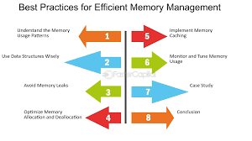
OBJECTIVES:
The main objectives of this project in compiler design are:
1. Minimize memory usage
2. Reduce fragmentation
3. Maximize performance
4. Ensure stability
5. Support scalability
6. Enable portability
7. Facilitate parallelism
8. Promote compatibility

Slide 9
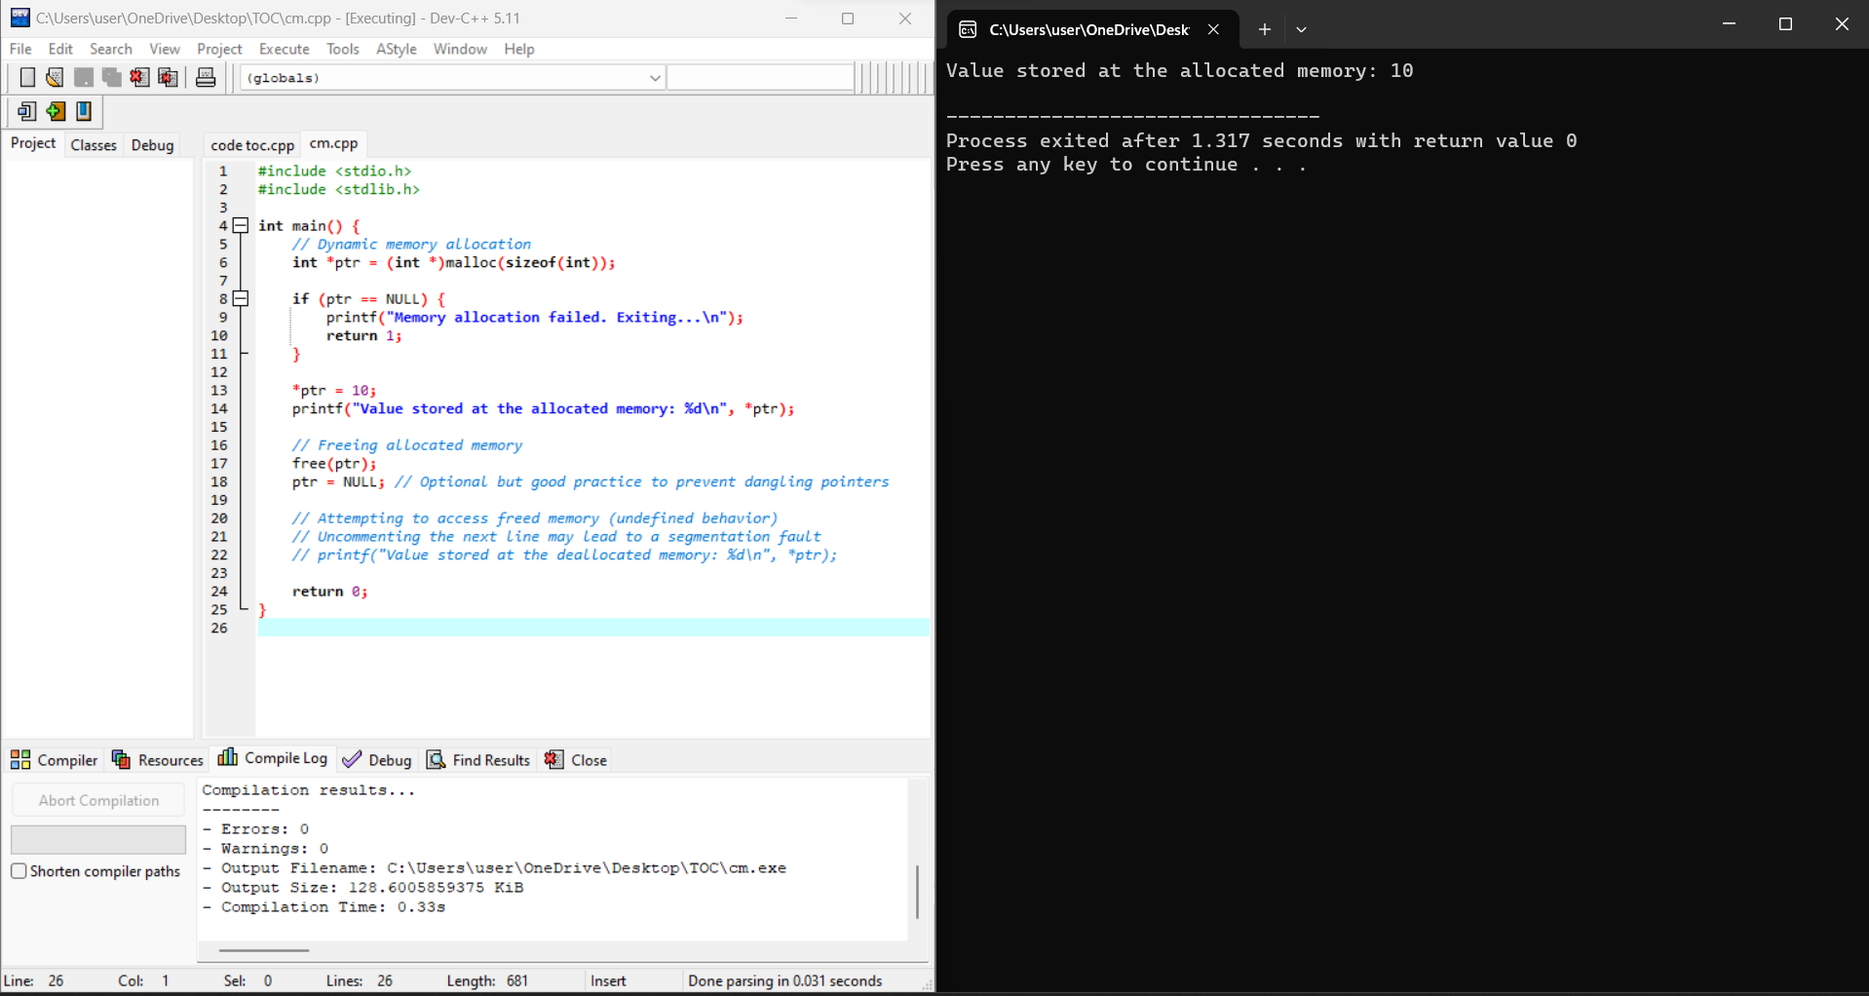
Implementation:

Slide 10
CONCLUSION:
Finally we concluded that it is essential for optimizing performance, reducing resource usage, and ensuring program stability.
By minimizing memory consumption, reducing fragmentation, and maximizing performance, compilers can operate more effectively, leading to faster compilation times and more efficient execution of compiled programs.
While challenges persist, ongoing research and exploration into novel strategies and hardware advancements offer promising avenues for further improvement.
The insights gained from this project have practical implications for compiler development and programming language design, highlighting the continued importance of efficient memory management in the ever-evolving landscape of software engineering

